Slide 1



SYRIA TEL COMPANY
MACHINE LEARNING ALGORITHMS TO PREDICT CUSTOMER CHURN
By: Cynthia Dalmas

Slide 2


Overview
BUSINESS PROBLEM
01
DATA UNDERSTANDING
02
DATA PREPARATION
03
MODEL CONSTRUCTION
04
EVALUATION OF METRICS
05
DEPLOYMENT OF MODEL
06
FINDINGS
07
RECOMMENDATIONS
08
CONCLUSIONS
09

Slide 3

Introduction
This project entails building a classifier model to predict whether a customer will stop doing business with Syria Tel, a telecommunications company. This is a binary classification problem.
Most naturally, telecommunication businesses would be interested in reducing how much money is lost when a customers does not stick around for a long time.

Slide 4
DATA UNDERSTANDING
The dataset contains call details of 3333 customers with 21 features and a dependent churn parameter with two values: Yes/No.
Some features include information about the number of incoming and outgoing messages and voicemail for each customer.
Most independent variables have a normal distribution

Slide 5
METHODOLOGY
The following methods were followed in order to meet the objectives of the project.
DATA CLEANING
Irrelevant columns were dropped from the dataset, Checking for missing values, checking and dropping duplicates & label encoding was done.
EXPLORATORY DATA ANALYSIS
Performing a descriptive statistics, Checking the distribution of the columns of the data set, using chart and diagrams
MODELING
Six Supervised Machine learning models were fit on the cleaned dataset and classisfication metrrics recorded
EVALUATION OF METRICS
All model performances was evaluated against each other.
MODEL DEPLOYMENT
Checking the distribution of data set, using chrt and diagrams

Slide 6
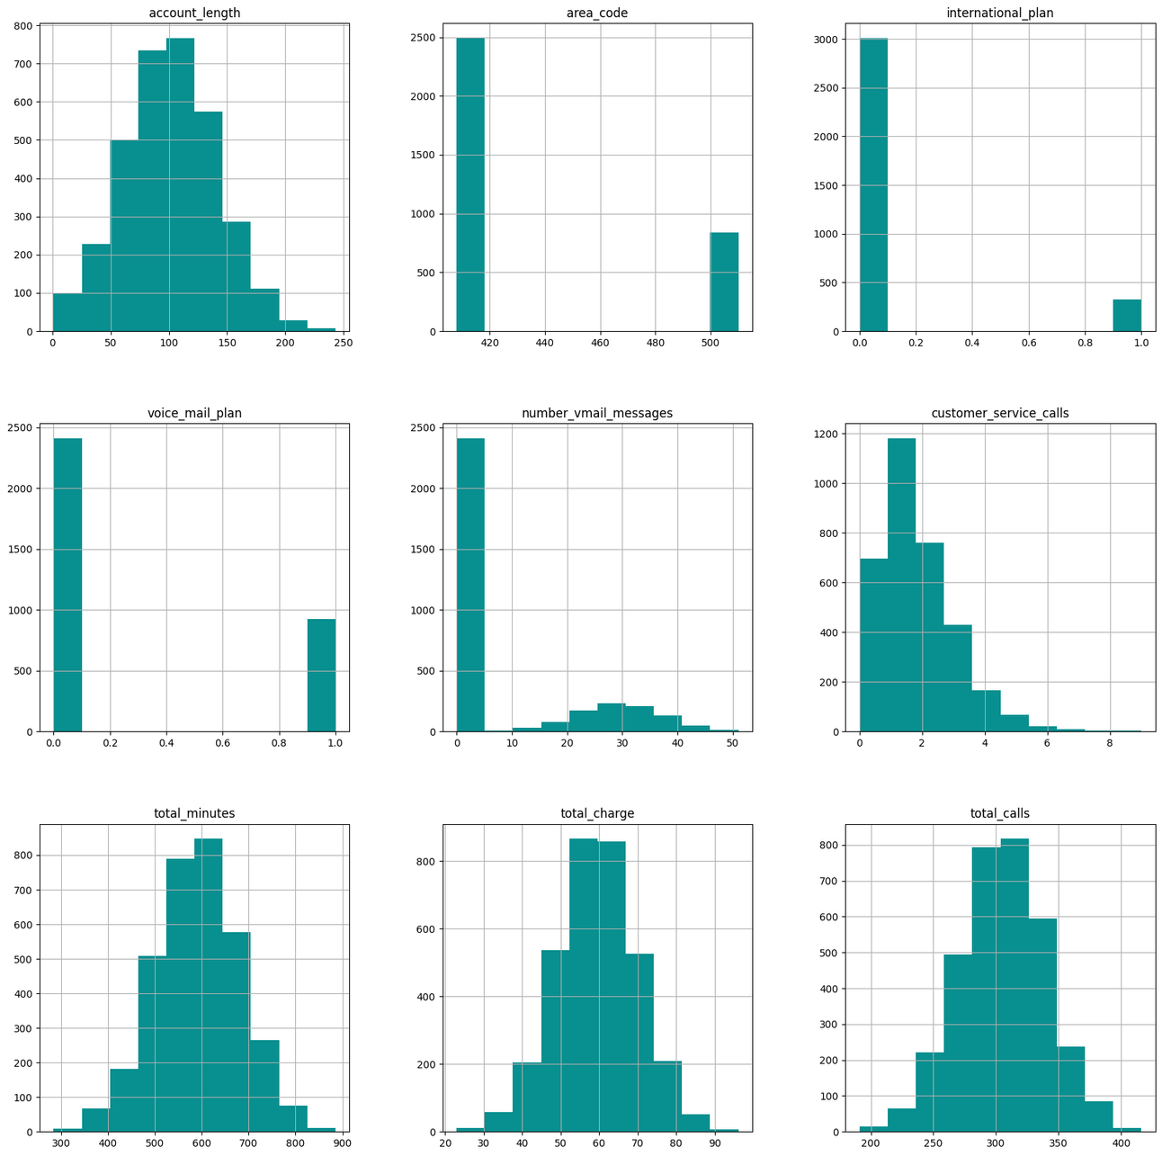
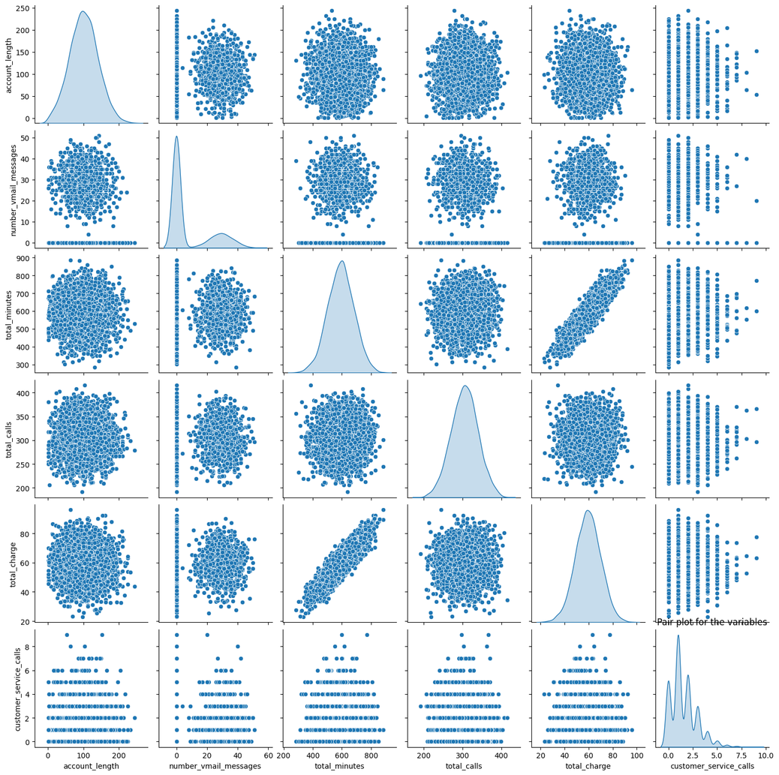
EXPLORATORY DATA ANALYSIS
Fig. 1: Histograms,indicates data imbalance in some features and a normal distribution in some
Fig. 2: Pairplot for checking for relationships between the variables

Slide 7
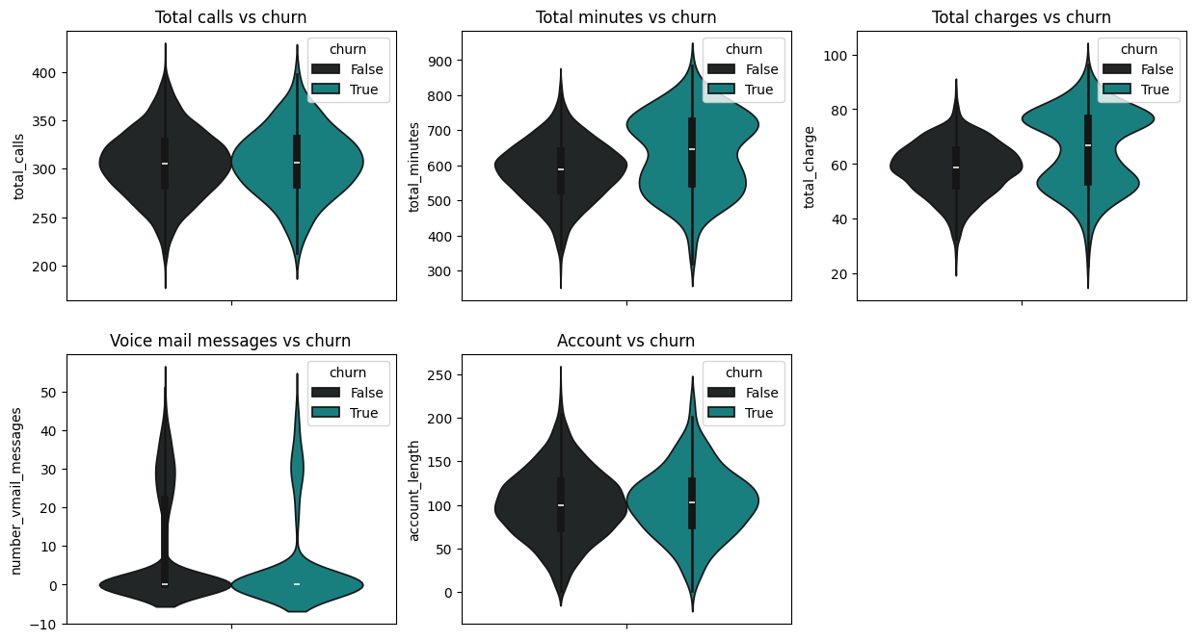
EXPLORING CHURNING FACTOR WRT TOTAL CALLS,TOTAL MINUTES,TOTAL CHARGE,ACCOUNT LENGTH,No of VOICE MAIL MESSAGES
The violin plots, Churning factor is quite visibile among customers who incured high charges.

Slide 8
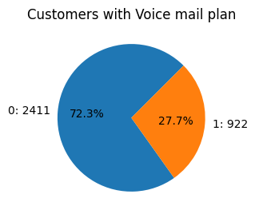
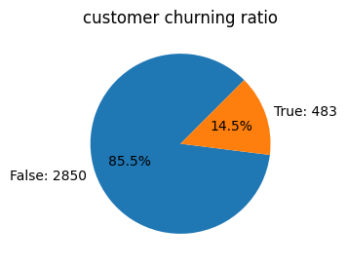
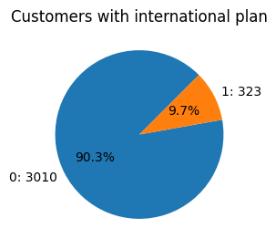
EXPLORING INTERNATIONAL PLAN, VOICE MAIL PLAN & CHURNING
A bi-variate analysis of these variables indicates that 27.7% had voice mail plan,14.5% churned from the company, 9.7% had international plan as shown by the pie plots.

Slide 9
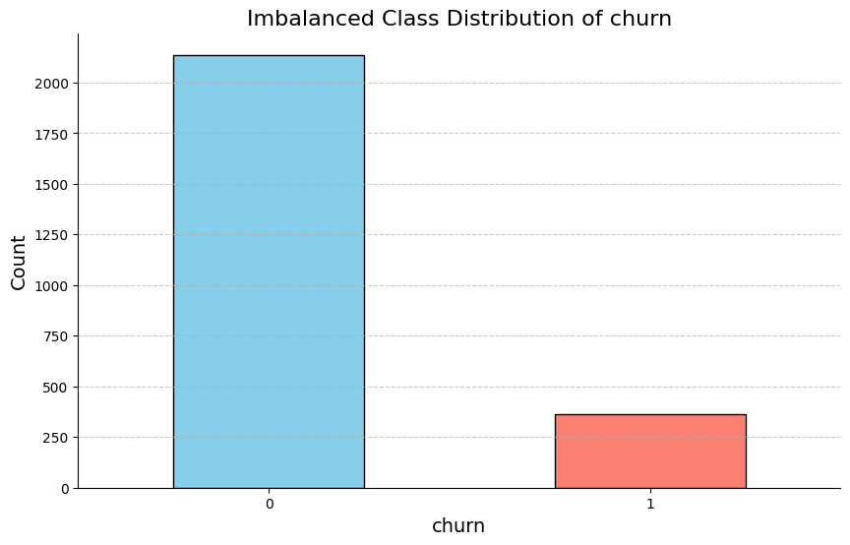
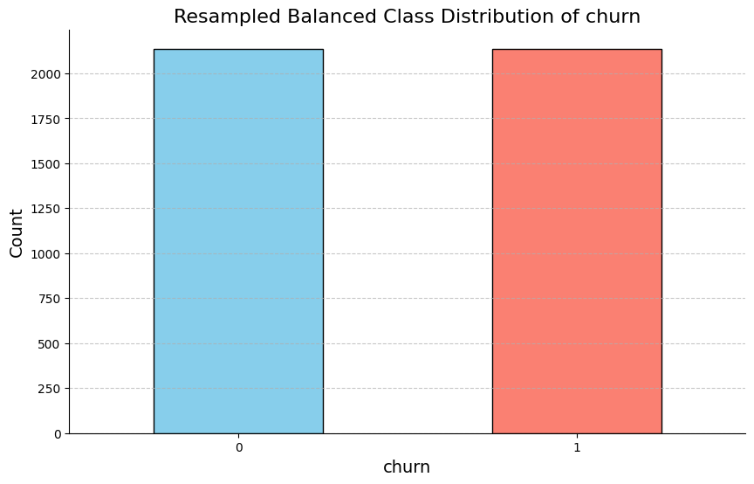
HANDLING THE CLASS IMBALANCE IN THE DATASET
Class imbalance can skew model results, we therefore resample to balance the dataset.

Slide 10
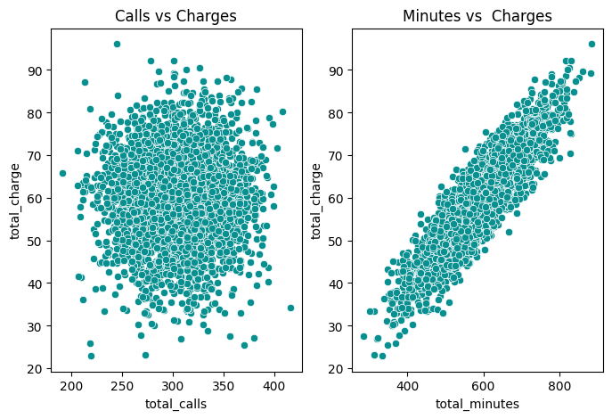
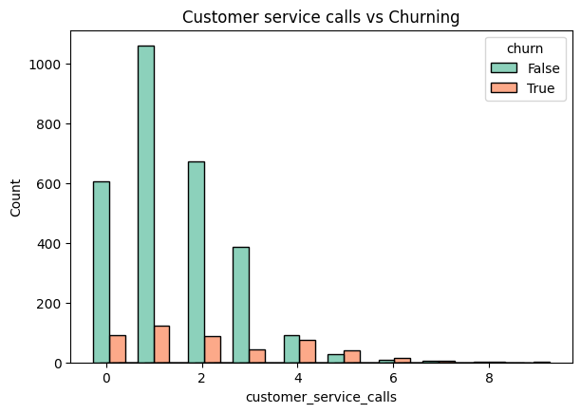
EXPLORING CALLS, TALK TIME MINUTES VS CHARGES
Fig 1:The Scatter plot Indicates low or no relationship between calls and charges
Fig 3:The Histogram Indicates that most customer who left the company had contacted customer service more that once.
Fig 2:The Scatter plot,Indicates a perfect relationship between Minutes and Charges

Slide 11
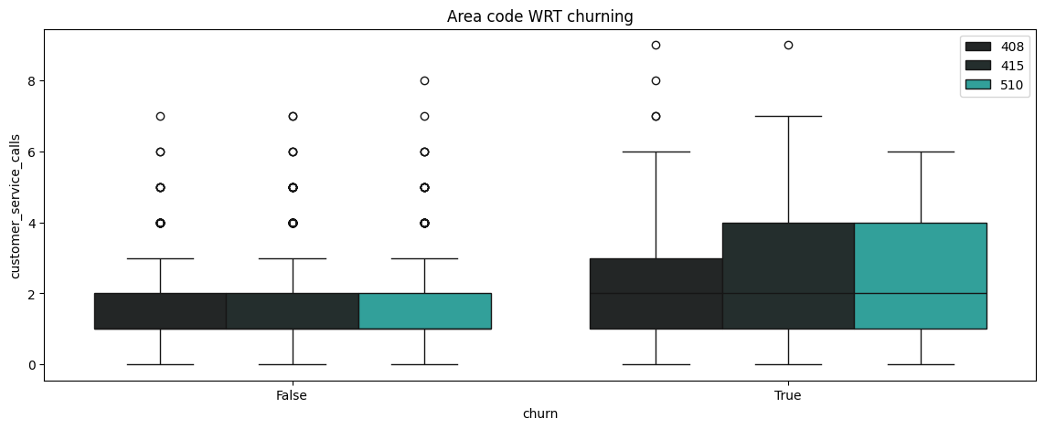
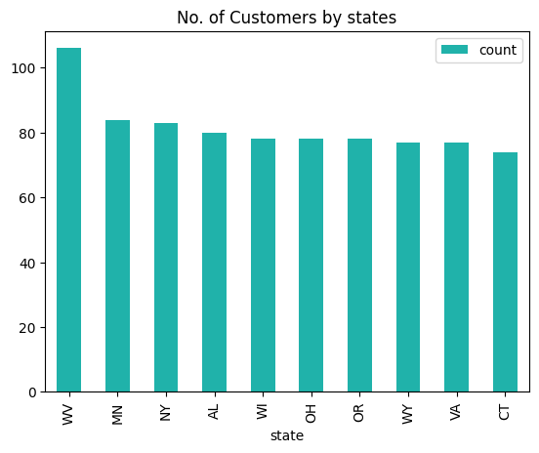
EXPLORING STATES WRT CHURNING
Fig.1 The boxplots indicates that Customers from area codes 510 & 415 showed high chances of churning.
Fig.2. The Histogram indicates that WV, MN, NY,AL,WI,OH,OR,WY,VA and CT are amongest the top ten states that telecom services were commonly used.

Slide 12
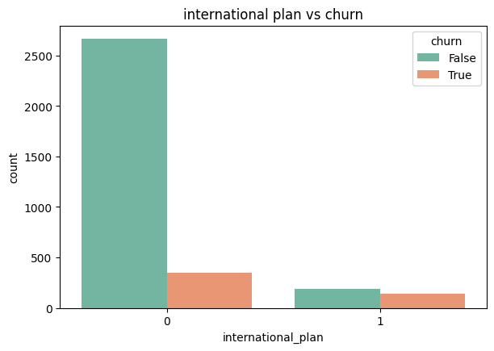
HYPOTHESIS TESTING
Hypotheses:
𝐻0 : Having an international plan has no affect on whether a customer would churn or not
𝐻𝐴 : Having an international plan has an affect on whether a customer would churn or not
TtestResult(statistic=inf, pvalue=0.0, df=1.0)
The p-value is less than the significance level 5%,, we can conclude that it is statistically significant that having an international plan has an affect on whether a customer would churn or not.

Slide 13
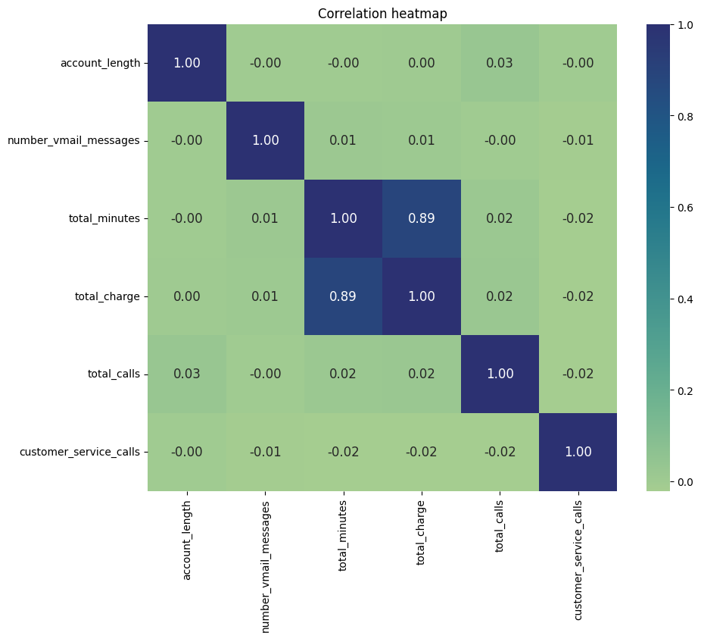
CORRELATION
The correlation heatmap plot shows a negative or no relationship among the variables, which is a good thing as we do not want multicollinearity
There is a perfect correlation between Total charges and total minutes

Slide 14
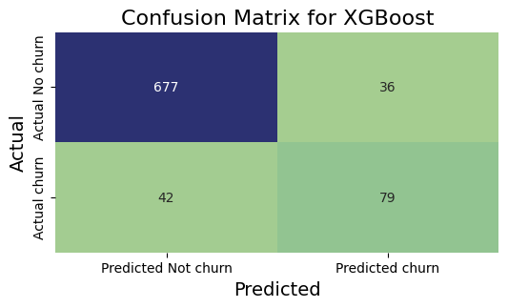
ANALYZING THE CONFUSION MATRIX OF XGBOOST MODEL
The upper-left quadrant displays the number of true negatives.-677
The bottom-left quadrant displays the number of false negatives.-42
The upper-right quadrant displays the number of false positives-36
The bottom-right quadrant displays the number of true positives.-79
From this confusion matrix the model correctly predicts many true negatives.-677
It appears slightly more likely to predict a false negative than a false positive.
The XGBOOST model also predicts lesser false positive -33 which shows that its a good model.

Slide 15
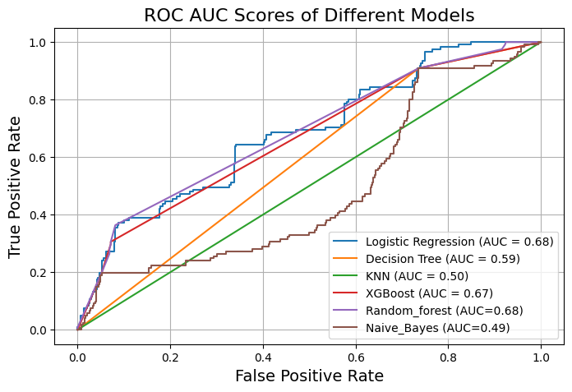
XG-BOOST CLASSIFICATION METRICS
ACCURACY
PRECISION
91%
94%
RECALL
F1-SCORE
95%
95%
With an accuracy of 91% after tuning the XGBOOST model. We therefore conclude that XGBOOST is the perfect model for this classification problem.

Slide 16

FINDINGS
XGBOOST model was the best to predict churning among customers in this classification problem.
The classification metrics of the model were: Accuracy-91%,Precision-94%, Recall-95% and F1-Score-95%.

Slide 17
RECOMMENDATIONS
I would recommend that Syria Tel Company should use large datasets to test the performance of the model.
Syria Tel company can do product development more frequently to keep up with the frequent change in customer taste.
Add more enticing features to their products according to daily trends in fashion, music, entertainment, sports and holidays.
Invest more on advertising to create more awareness amongst it's customers and even gain new ones.
Take customer service seriously, analyze daily calls and ensure all reported issues are resolve in a timely manner. This is because the analysis showed, most customers who churn, had contacted the Customer service more than once.
Reduce charges on minute rate to prevent the 19% of customers who churned due to charges incurred from churning.
Aaron Loeb
Alfredo Torres
Daniel Gallego
Olivia Wilson
CEO & Founder
Project manager
CEO & Founder
IT Expert
Marketing Head

Slide 18



THANK YOU!
CYNTHIA DALMAS
Cakinyi97@gmail.com
NAIROBI, KENYA

